Slide 1
Lightweight Rules Engine
Columbia Enterprise Developers Guild
8/10/2011
Eric Notheisen

Slide 2
Technologies Used
Factory Pattern
Chain of Responsibility Pattern
Reflection
Linq to Objects
Linq to Xml

Slide 3
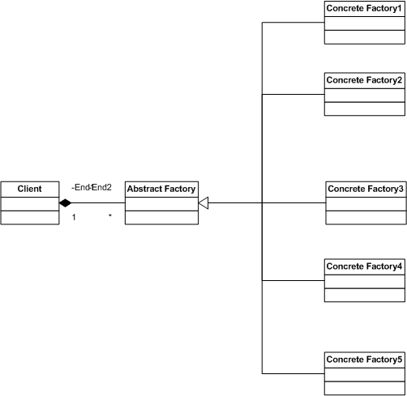
Factory Pattern
Encapsulates operations
Hides the implementation from the client
It promotes consistency among products
Demo

Slide 4
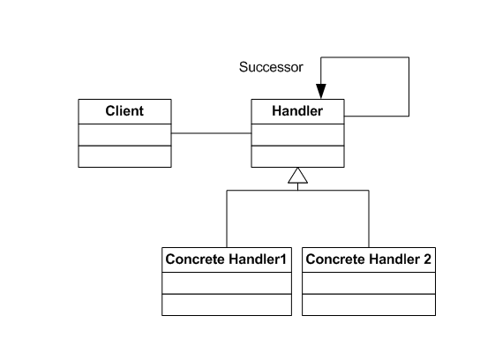
Chain of Responsibility Pattern
Basic pattern for a rules engine
Successor actions dependent on success of previous action.
Demo

Slide 5
Lightweight Rules Engine
Flexible
Rules set in database and not in compiled code
Reflection allows additional rules
Less Regression Testing
Rules can be added without recompiling the engine.
Rules based on Product.

Slide 6
Database
Review Table Structure
Show stored procs

Slide 7
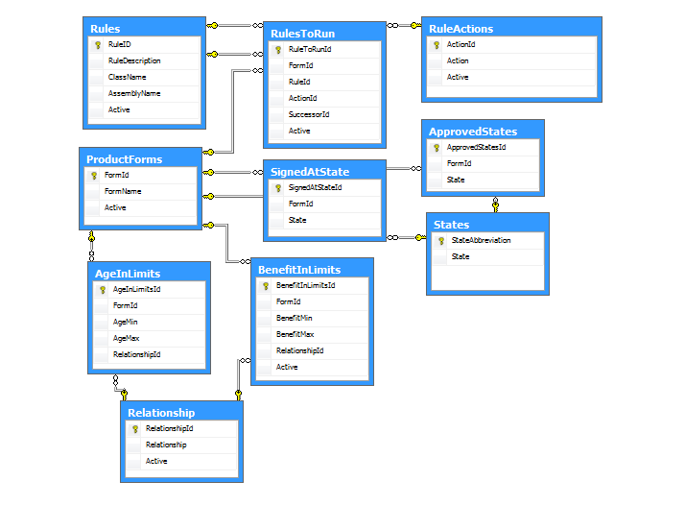
Table Structure of the Rules Engine

Slide 8
Rule Pattern
Test for Catastrophic failure
Test for pass or fail

Slide 9
public override int HandleRequest(ref int exitPath, ref XElement Application)
{
var vState=Application.Element("State");
if (((String)vState) == String.Empty)
{
exitPath = 3;
ErrorLogging el = new ErrorLogging();
var vAppId = Application.Attribute("AppId").Value;
el.AppId = Convert.ToInt32(vAppId);
var vFormId = Application.Element("FormId").Value;
el.FormId = Convert.ToInt32(vFormId);
el.ErrorDescription = "The value of State was Empty";
ErrorLogging.Insert_ErrorLogging(el);
return exitPath;
}
Boolean TestIsTrue = false;
string State= ((string)Application.Element("State"));
String FormId=(String)(Application.Element("FormId"));
foreach (StateIsApproved sia in lstStateIsApproved)
{
if (sia.State==State && sia.FormId==Convert.ToInt32(FormId))
{
TestIsTrue=true;
}
}

Slide 10
if(TestIsTrue)
{
exitPath = 1;
return 1;
}
else
{
exitPath = 2;
ErrorLogging el = new ErrorLogging();
el.AppId = (int)Application.Attribute("AppId");
el.FormId = (int)Application.Element("FormId");
el.ErrorDescription = "The value of State was not in the approved list";
ErrorLogging.Insert_ErrorLogging(el);
return 2;
}
}

Slide 11
Insurance Products
Products
Group Life Policy
Individual Life Policy
Family Life Policy

Slide 12
Group Life Policy
Form Number 1375
Age in Limits
Adult 21-61
Child 0 - 23
Approved State
List In Database
Signed At State
Application Signed in Approved State
FL, GA, IL, NC, SC
Benefit Limit
Adult 10K-100K
Child 10K – 10K

Slide 13
Individual Life Policy
Form Number 1661
Age in Limits
Adult 21-61
Child 0 – 23
Signed At State
Application Signed in Approved State
AL, GA, NC, SC
Benefit Limit
Adult 20K-200K
Child 20K – 20K

Slide 14
Family Life Policy
Form Number 1662
Approved State
List In Database
Signed At State
Application Signed in Approved State
FL, GA, IL, NC, SC
Benefit Limit
Adult 10K-100K
Child 10K – 10K

Slide 15
Demo
We can debug if the concrete factory has a reference.
We do not need a reference after the test is compiled

